Slide 1
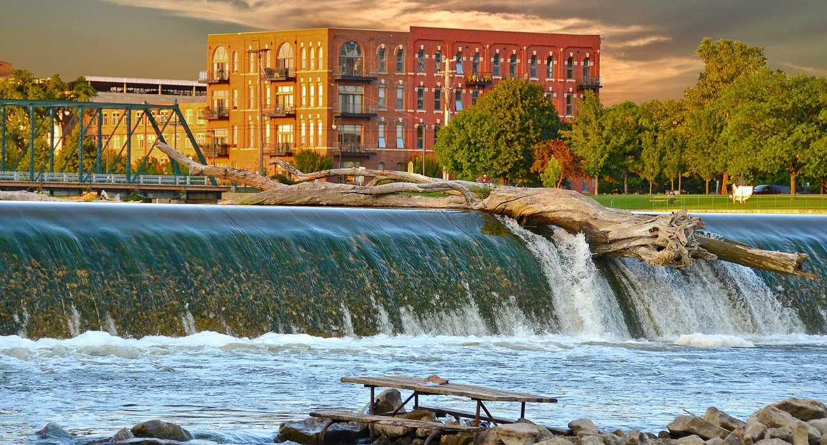
Micro Local Business Enterprise (MLBE)
2020 Registration Program
July 7, 2020

Slide 2
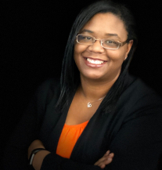
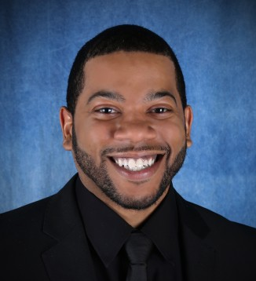

Presenters
  Ciarra C. Adkins, JD
  Equity Analyst
  City of Grand Rapids
  Office of Equity & Engagement
  cadkins@grand-rapids.mi.us
  P: 616-456-4657
  Alvin Hills, IV
  Business Developer
  City of Grand Rapids
  Office of Equity and Engagement
  ahills@grand-rapids.mi.us
  P: 616-456-3449
2

Slide 3


MLBE Program Partners
3

Slide 4
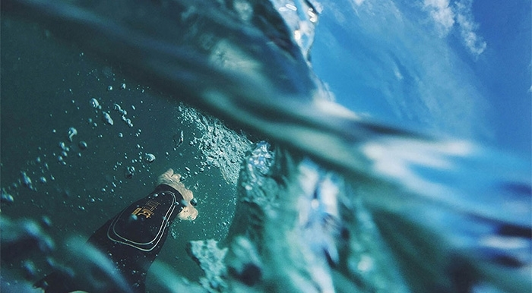
Quote and Image Slide
RIVER EQUITY STATEMENT
To create a River for All that honors both the history and the future of our river by embedding racial and economic equity principles in all that we do both in the water and along the river banks.
We understand that all river-related decisions today will have an immense generational impact on the residents of our city.”
“
4

Slide 5

Capacity Building
5

Slide 6
Why implement a MLBE Registration Program for the River Restoration?
River for All
City of Grand Rapids Strategic Plan and commitment to equity
Conversations in the construction industry
Need for capacity building
Late Fall 2020/Winter 2021 river construction bidding opportunities
Local job and wealth creation
6

Slide 7
About the Program?
Timeline
July 7, 2020 - October 31, 2020
Goal
30-40 new companies registered on the City of Grand Rapids MLBE List
Who should apply?
Kent County based small, minority, and/or women owned firms
How do I apply?
Through a designated partner agency
7

Slide 8
Our Strategy
1
+ Partnerships
2
- Decrease Systemic Barriers
3
+ Increase MLBE Registrations

Slide 9

+ Partnerships
Importance of Capacity Building
It is intentional that we offer strategic consulting dollars to our participating partners
We recognize that this endeavor requires both time and leveraging of their social capital

Slide 10
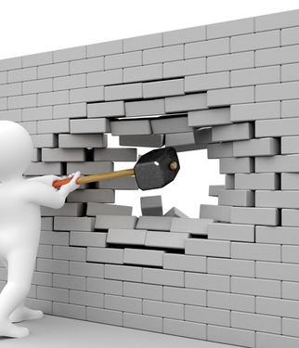
- Decrease Systemic Barriers
Net Worth Statement
This requirement is costly for many small companies and can be time intensive
The City will contract with an accountant who can assist MLBEs gather this documentation, and supplement up to $500 of the costs
Document Translation
The City of Grand Rapids will translate the MLBE registration application and supporting materials into Spanish

Slide 11

+ MLBE Registrations
Virtual Informational Sessions:
How can your work impact the River for All Development?
Landscapers, Thursday, July 9, 2020
(5-6pm)
Trucking Contractors, Thursday, July 16, 2020 (5-6pm)
Concrete Contractors, Thursday, July 23, 2020 (5-6pm)
Excavation Contractors, Thursday, July 30, 2020 (5-6pm)
General MLBEs, Thursday, August 6, 2020
(5-6pm)

Slide 12
How is it funded?
Total Budget: Up to $75,000
W.K. Kellogg Foundation Grant
Up to $67,500
City of GR – General Operating Funds
Up to $7500
Strategic Consulting
2. MLBE Registration
3. Eligible MLBE Leads
4. ½ Net Worth Statement Subsidy
½ Net Worth Statement Subsidy
12

Slide 13

How are funds allocated?

Slide 14
Payment Chart
Deliverable | Payment
Strategic Consulting | Flat $5000 per organization
Referral (LEADS) | $50 per qualified lead
Complete MLBE Application Registrations | $300 per eligible registration
Registration Bonus for Specific Construction Related Fields | $50 per eligible registration
Net Worth Statement | $500 City covered costs

Slide 15
How do I know if I am an MLBE?
Eligibility Criteria
Business Age – in operation for at least 2 years
2. Location – Kent County
3. CGI/Vendor Registration
4. Business Size as determined by North American Industry Classification System (NAICS)Code
  Employee/revenue 3 year average must be 25% or lower than the SBA standard
5. Net Worth Statement
  CPA or Bank should validate your net worth is less than $250K
15

Slide 16




Thank you to our river restoration partners
16

Slide 17
THANK YOU! | QUESTIONS?
Insert Image

